Slide 1
HEBRA Enclosure
2020 – 2025 Security Strategy

Slide 2
Current Security Statistics
HEBRA:
  Minor Incidents: 5* (2020 – To Date)
    Example: Beam Theft, Gate Motor Theft, Other Petty Theft
  Major Incidents: 8* (2020 – To Date)
    Example: Major robbery, Hijacking, Assault & Battery Robbery
* Known Incidents only.

Slide 3
Current Security Statistics
Edenvale & Surrounds:
  Minor Incidents: 10* (July 2020 – To Date)
    Example: Beam Theft, Gate Motor Theft, Other Petty Theft
  Major Incidents: 21* (July 2020 – To Date)
    Example: Major robbery, Hijacking, Assault & Battery
* Known Incidents only.

Slide 4
HEBRA Levy Rates
Current Levy Amount:
  R450.00 Per House
Amount of Houses in Enclosure:
  334 Houses
Current Levy Payment Rates:
  38%
122 Houses
Income of R49 000.00 per month (average of R400.00 per house)

Slide 5
HEBRA Levy Rates
Current Monthly Security Bill (Average):
  R 47 000.00 per month (12 Hour Guards/2 Guards, 1 Scooter Guard)
Current Expenses (Averages):
  R25 000.00 Enclosure Maintenance (Average per annum)
  R12 000.00 Enclosure Insurance (Average per annum)
Current Monthly Income (Average):
  R49 000.00
Monthly Difference (Average):
  +R2 000.00 Retained income monthly (average)

Slide 6
HEBRA Levy Breakdown
R450.00 Levy per household:
  86% To Mamba (R386.00)
  1.77% To Insurance (R7.97)
  12.45% To Enclosure Maintenance & Debt Payment (R56.03)

Slide 7
HEBRA Levy Breakdown
R52 000.00 Levy Average:
  R47 000.00 To Mamba
  R972.72 To Insurance
  R4 027.28 To Maintenance and Debt (on average)

Slide 8


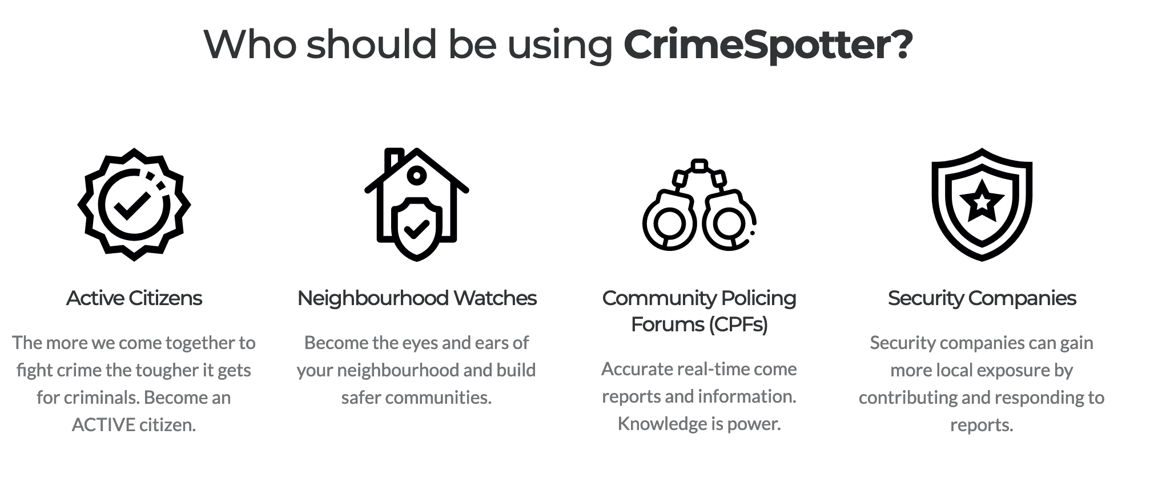
HEBRA
Security Strategy & Initiatives
Crime Spotter App Partnership

Slide 9

HEBRA
Security Strategy & Initiatives
Namola Plus Partnership

Slide 10
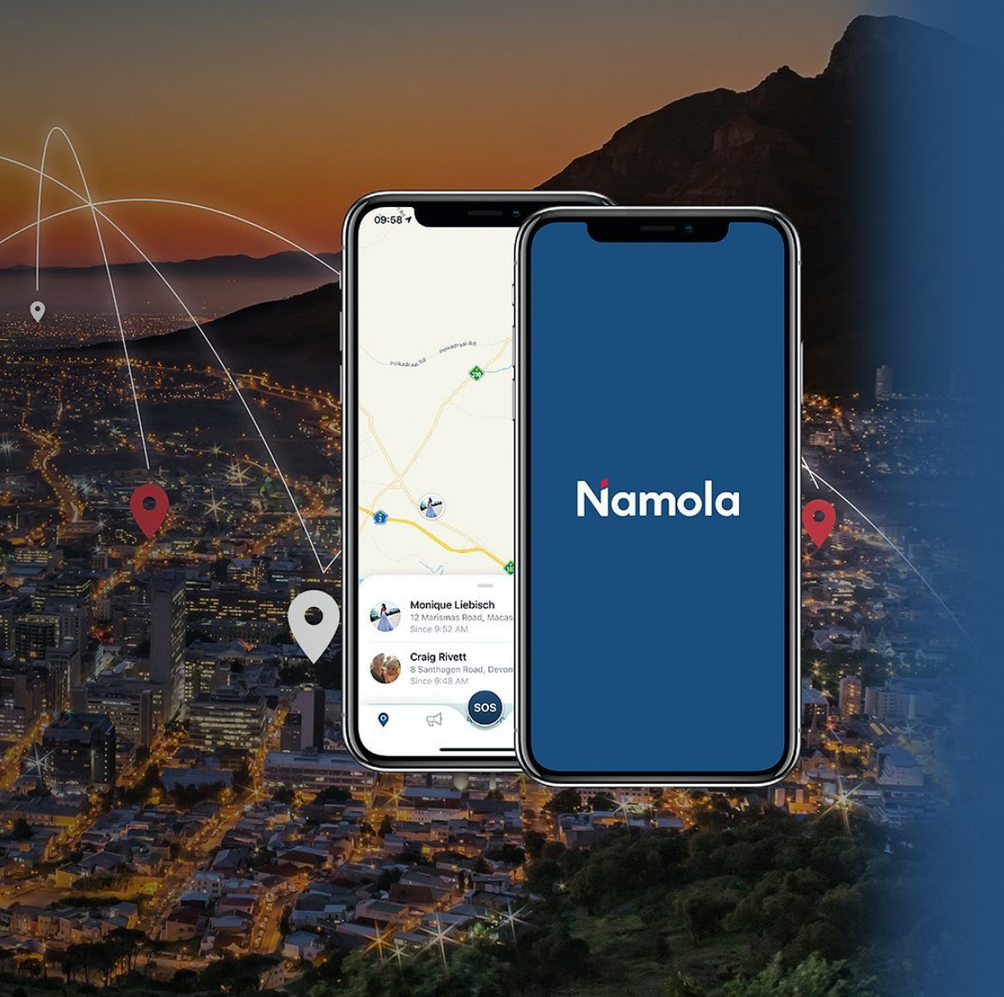
HEBRA
Security Strategy & Initiatives
Namola Plus Partnership

Slide 11
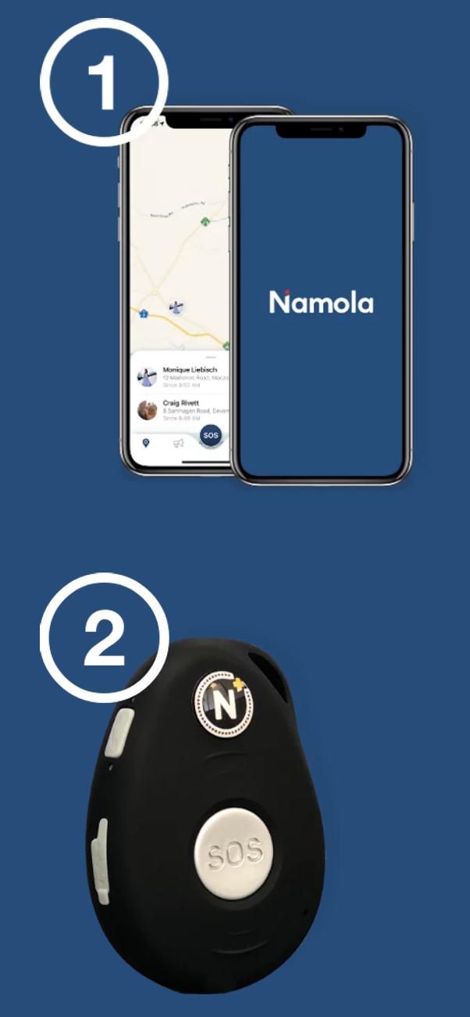
HEBRA
Security Strategy & Initiatives
Namola Plus Partnership

Slide 12
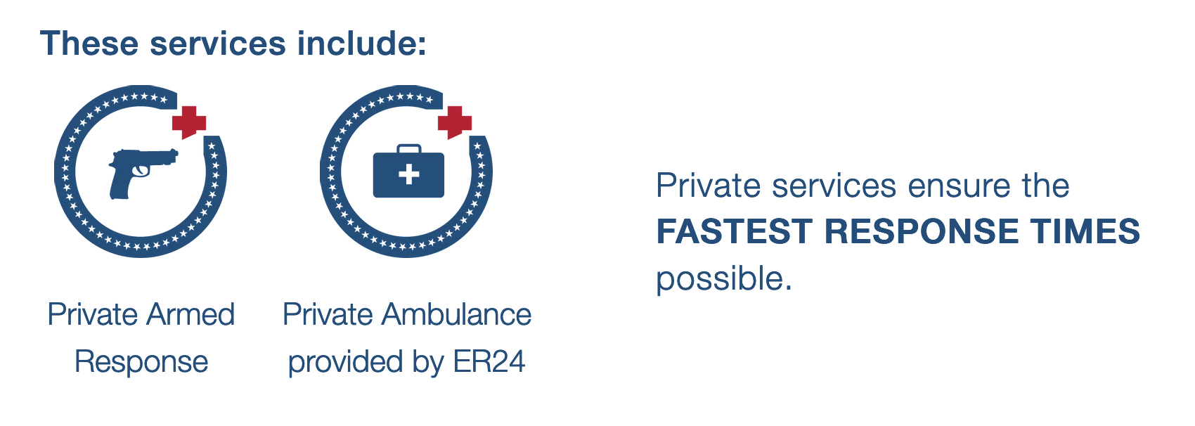
HEBRA
Security Strategy & Initiatives
Namola Plus Partnership

Slide 13

HEBRA
Security Strategy & Initiatives
Monthly Safety & Security Talks in the park
Special Thank You
to Brian Smith

Slide 14
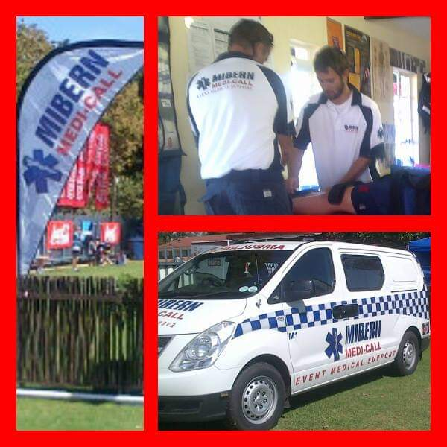
HEBRA
Security Strategy & Initiatives
Monthly Safety & Security Talks in the park

Slide 15
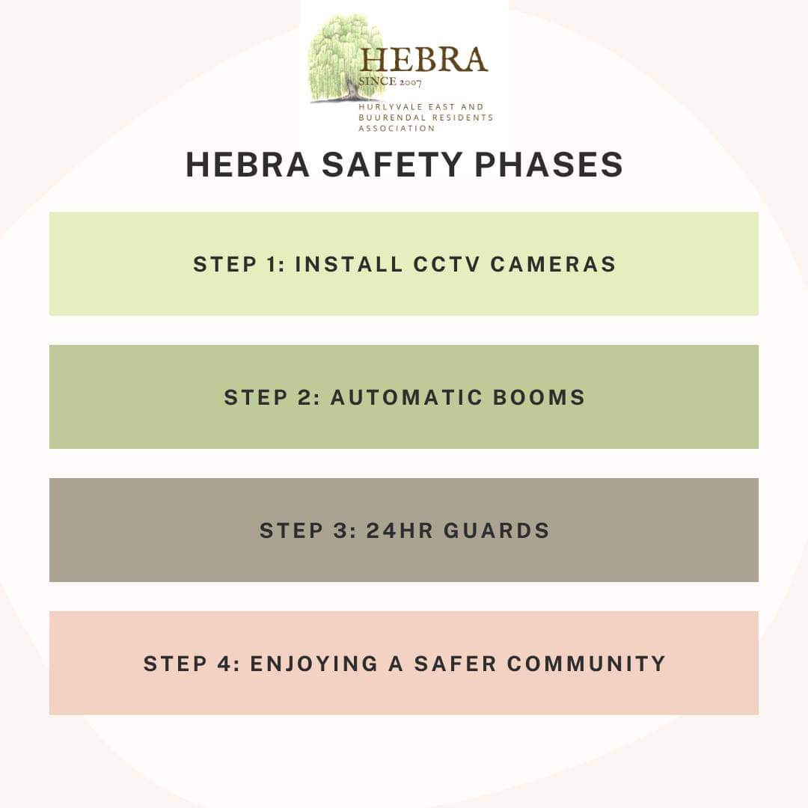
HEBRA
Security Strategy & Initiatives
Phased Security Approach
Notes:
Phase 1 - Cameras
Phase 2 - Automated booms with biometric tags
Phase 3 - Booms at all other gates
Phase 4 - Automated booms with biometrics at every entrances

Slide 16





Slide 17
HEBRA
Security Strategy & Initiatives
Phase 1:
  CCTV Cameras
  CAPEX Model: R512 735.14 (R32 045.95 per pole)
  OPEX Model: R11 052.95 per month (27 Cameras)
  Monitoring Cost: R8 505.00 (21 Cameras)
  Total: R19 557.95 Ex Vat (60 Months)

Slide 18
HEBRA
Security Strategy & Initiatives
Phase 2:
  Automated Booms & RFID Entry At Main Entrances
  CAPEX Model: R330 995.59
  OPEX Model: R8 112.70 (60 Months)

Slide 19
HEBRA
Security Strategy & Initiatives
Phase 3:
  24 Hour Guards
  OPEX Model: R72 369.45 per month (4 Guards, 7 Days per week)

Slide 20
HEBRA
Security Strategy & Initiatives
Phase 4:
  Automated Booms, Biometric & Turnstiles – All Gates
  CAPEX Model: TBC (Forthcoming)
  OPEX Model: TBC (Forthcoming)
Vote On:
  Security Strategy & Phases

Slide 21
HEBRA
Security Strategy & Initiatives
Raising of OPEX Levy Rates:
  R500.00 Per House (Excluding “One-Fee” Option)
  R1 150.00 Per House (Current ”One-Fee” Levy Rate of R500.00 & incl. Armed Response)
  Household notice delivery & Levy Contract Enforcement (Community-involvement)
Raising of Special Levy Rates:
  R1 100.00 Annual Special Levy per house (Average)

Slide 22
HEBRA
Security Strategy & Initiatives
Current OPEX Amounts:
  R500.00: R61 000 (122 Houses)
Raising of Special Levy Rates:
  R1 100.00: R150 700.00 (137 Houses)
Vote On:
  OPEX Levy Rates

Slide 23
HEBRA Special Levy Breakdown
R150 700.00 (R1 100.00 across 137 households):
  R97 955.00 To Enclosure Maintenance and Replacement Requirements
  R34 285.00 To Surplus & Emergency Funding
  R18 460.00 To Legal, City Council & Enclosure Levy Management
Vote on:
Special Levy Being Raised in 1 Month, or spread over 3 Months

Slide 24
Thank You
hebracommunity@gmail.com

