Slide 1
HEBRA Enclosure
2020 – 2025 SECURITY STRATEGY
2021 AGM

Slide 2
Current Security Statistics
HEBRA:
  Minor Incidents: 4* (2021 – To Date. 2020 = 5 Incidents)
    Example: Beam Theft, Gate Motor Theft, Other Petty Theft
  Major Incidents: 4* (2021 – To Date. 2020 = 8 Incidents)
    Example: Major robbery, Hijacking, Assault & Battery Robbery
* Known Incidents only.

Slide 3
Current Security Statistics
Edenvale & Surrounds:
  Security Incidents: 109* (2021 – To Date)
    Example: Beam Theft, Gate Motor Theft, Other Petty Theft, Major robbery, Hijacking, Assault & Battery
* Known Incidents only.

Slide 4
HEBRA Levy Rates
Current Levy Amount:
  R450.00 Per House
Amount of Houses in Enclosure:
  334 Houses (R150 300.00 income if all houses paid levy)
Current Levy Payment Rates:
  46%
  Roughly 152 Houses at R450.00 per house assumption - up from 39% in 2020
Income of R68 708.00

Slide 5
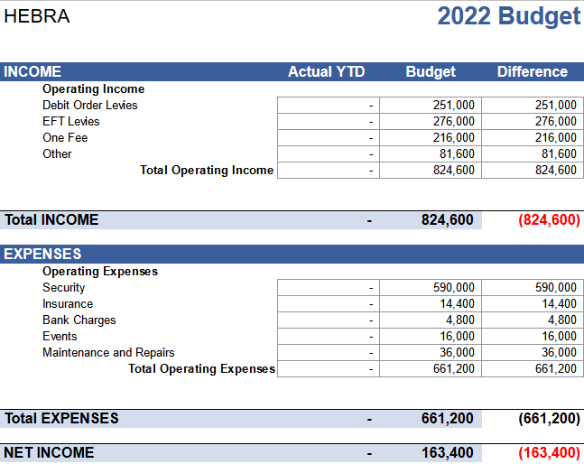
HEBRA Enclosure Budget

Slide 6


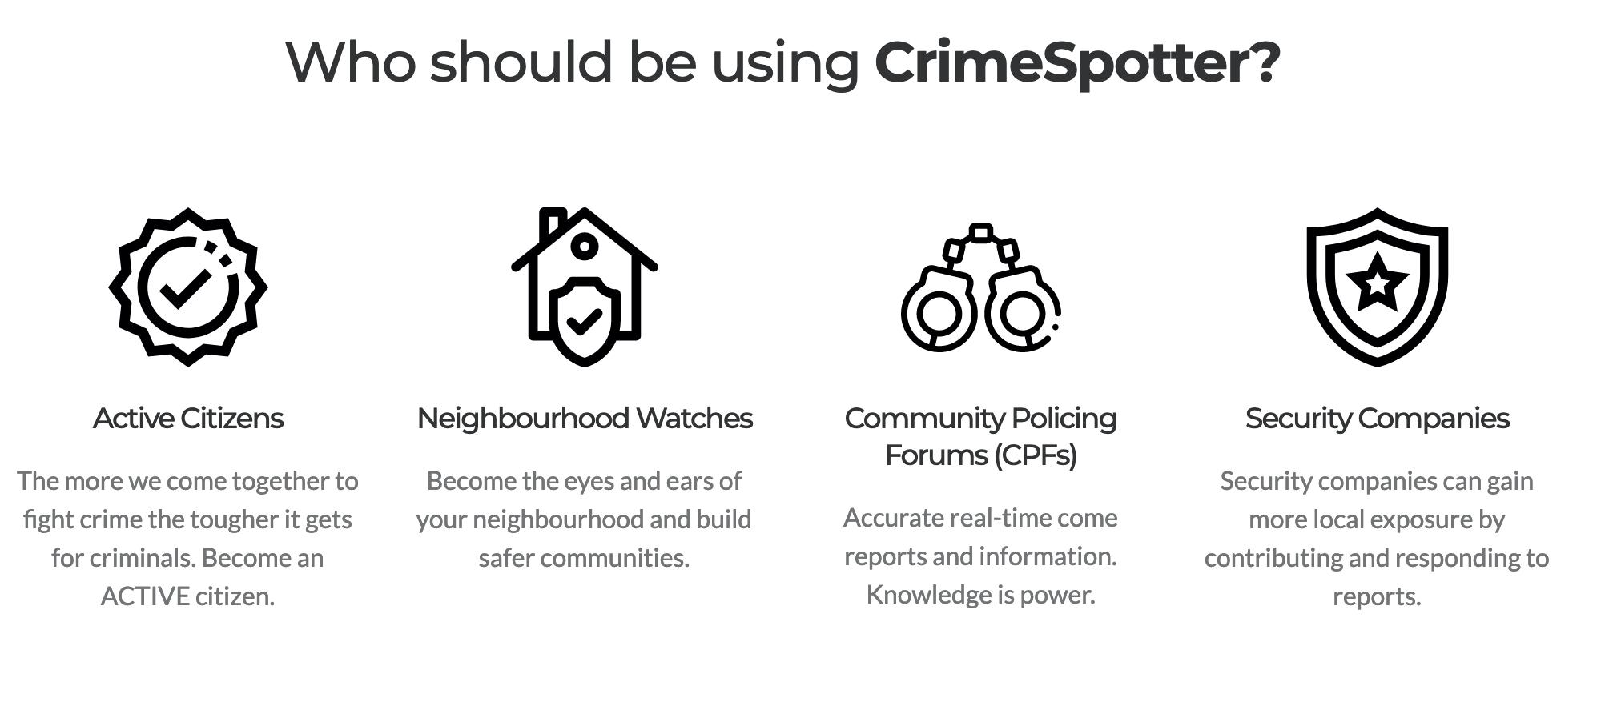
HEBRA
Security Strategy & Initiatives
Crime Spotter App Partnership

Slide 7

HEBRA
Security Strategy & Initiatives
Namola Plus Partnership

Slide 8
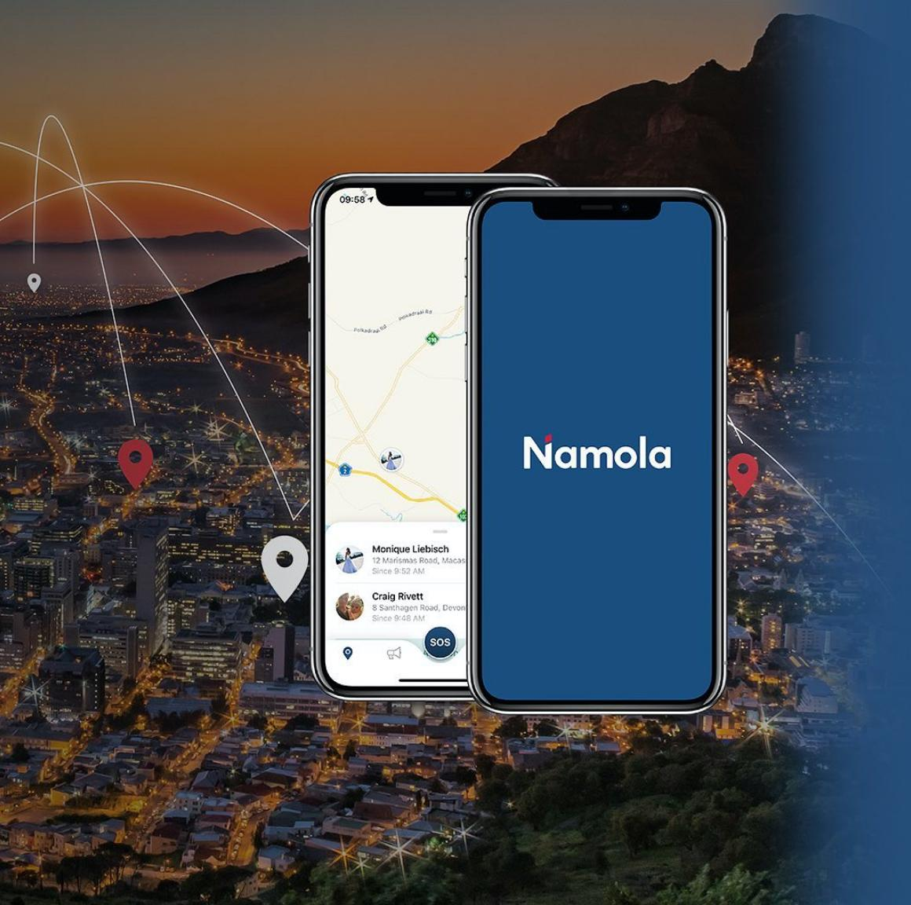
HEBRA
Security Strategy & Initiatives
Namola Plus Partnership

Slide 9
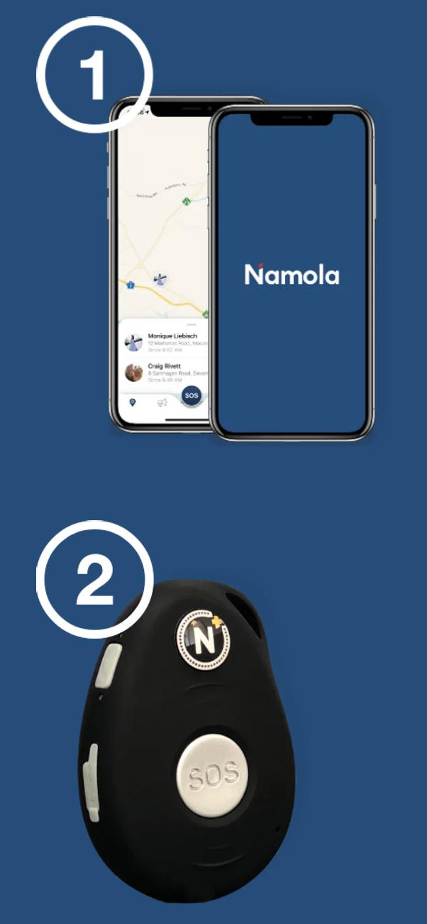
HEBRA
Security Strategy & Initiatives
Namola Plus Partnership

Slide 10
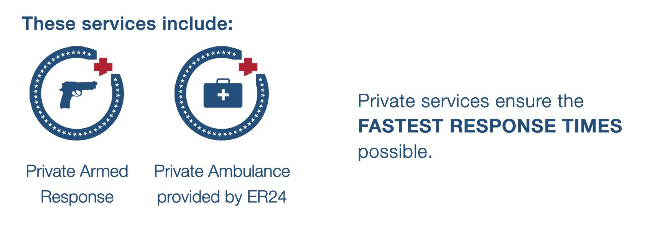
HEBRA
Security Strategy & Initiatives
Namola Plus Partnership

Slide 11
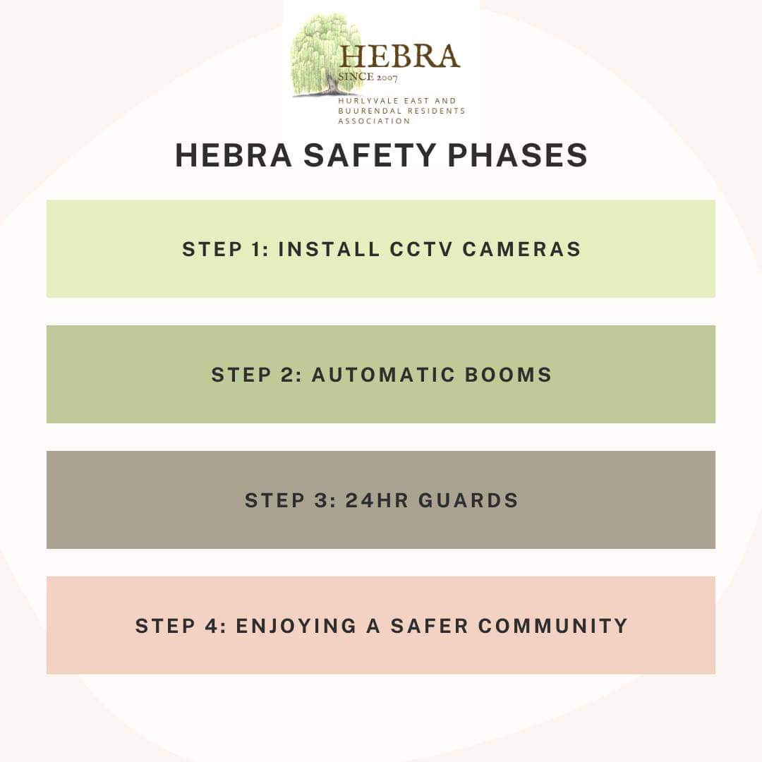
HEBRA
Security Strategy & Initiatives
Phased Security Approach
Notes:
Phase 1 - Cameras
Phase 2 - Automated booms with biometric tags
Phase 3 - Booms at all other gates
Phase 4 - Automated booms with biometrics at every entrances

Slide 12

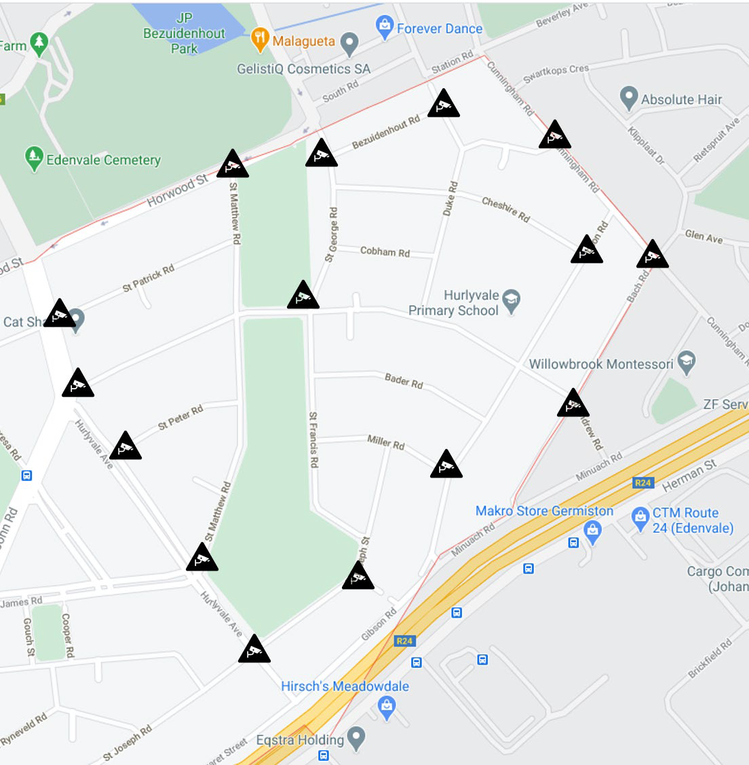




Slide 13
HEBRA
Security Strategy & Initiatives
Phase 1 (“Want”):
  CCTV Cameras
  CAPEX Model: R512 735.14 (R32 045.95 per pole)
  OPEX Model: R11 052.95 per month (60 Months)
  Monitoring Cost: R18 900.00 per month

Slide 14
HEBRA
Security Strategy & Initiatives
Phase 1 (“Reality”):
  CCTV Cameras
  CAPEX Model: R150 000.00 (Current finance)
  OPEX Model: TBC once finance contract is received
  Monitoring Cost: R18 900.00 per month

Slide 15
HEBRA
Security Strategy & Initiatives
Phase 2 (“Want”):
  Automated Booms & RFID Entry At Main Entrances
  CAPEX Model: R330 995.59
  OPEX Model: R8 112.70 (60 Months)

Slide 16
HEBRA
Security Strategy & Initiatives
Phase 2 (“Reality”):
  Counter-lever manual booms & license scanners
  CAPEX Requirements: R50 000.00 (Approximately)
  OPEX Requirements: R5 000.00 P/M (Approximately)

Slide 17
HEBRA
Security Strategy & Initiatives
Phase 2- continued (“Reality”):
  Guard Huts & boom removal
  Old huts’ removal : R20 000.00 (Approximately)
  Built St Matthew’s Huts: R50 000.00 (Approximately)

Slide 18
HEBRA
Security Strategy & Initiatives
Phase 3 (“Want”):
  24 Hour Guards
  OPEX Requirements: R72 369.45 per month (4 Guards, 7 Days per week)

Slide 19
HEBRA
Security Strategy & Initiatives
Budget Requirements (Asks):
“Want”:
  Capex: R843 730.73 (R5 551.00 Special Levy)
  Opex: R99 382.15 (R654.00 Increase in Levy)
“Reality”:
  Capex: R270 000.00 (R1 776.32 Special Levy)
  Opex: R23 900.00 (R158.00 Increase in Levy)
    including monitoring of CCTV
    excluding OPEX for CCTV installation (scooter guard removal)

Slide 20
Thank You
hebracommunity@gmail.com

